Slide 1

Technology Value Stream
Presented by Jon Green

Slide 2

Topics:
What is Technology Value Stream?
Lead Time vs Processing Time
Determining Lead Time

Slide 3

What is Technology Value Stream?
Technology value stream is a sequence of activities that an organization conducts to deliver a product, service, or experience to the end user. In terms of software, it represents the lifecycle of the product and the method in which it is delivered to the consumer. Some of the aspects that it includes are update methods, operational procedures, and delivery protocols.

Slide 4

Lead Time
Lead time in DevOps measures how much time has elapsed between committing code and deploying it to production. It also includes tracking the time spent on implementing, testing, and delivering changes to the codebase.
Lead times of minutes are more beneficial than lead times requiring months. Lead times of minutes are better because the developers receive fast and constant feedback regarding the project. This quick sharing of updates allows them to implement changes as soon as possible in addition to providing a consistent result.
Lead times in months provides a slower turnaround time for deployments. It also runs the risk of bigger issues occurring due to the developers not being updated on their progress in regular intervals. This can ultimately place more stress on the development team due to the lack of information and feedback being produced.

Slide 5
Processing Time
Processing time is a component of lead time. The process time begins once the developers receive the request / ticket to implement changes in the software. The processing time is heavily impacted by limiting WIP. Limiting WIP ensures that tasks are completed in their entirety before starting a task. This in turn produces a consistent result with along with an efficient use of time management to complete the task at hand.

Slide 6
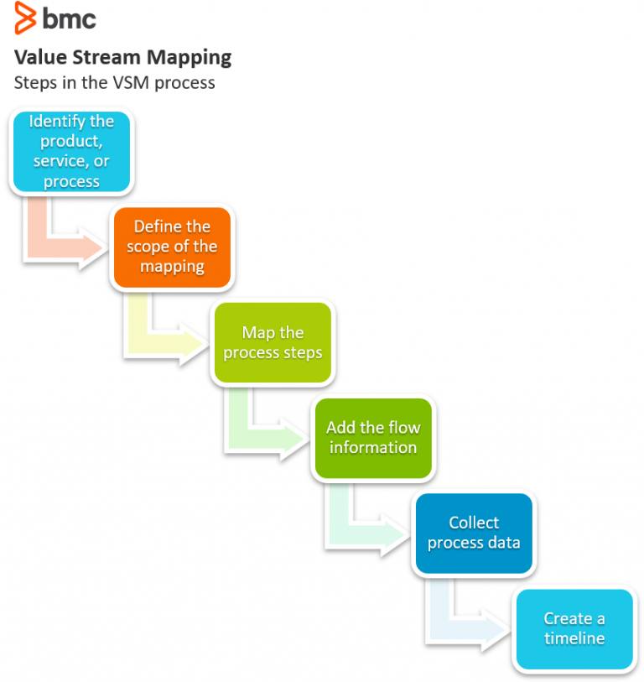
Technology Value Stream Example
Mathenge, J. (2021). Value Stream Mapping (VSM) Tutorial with Examples & Tips. BMC Blogs. https://www.bmc.com/blogs/value-stream-mapping/

Slide 7
Lead Time and Processing Time
The lead time heavily impacts the processing time. The processing time begins only once the work has begun by the developers on the required changes. The processing time is dependent on the lead time as it sets the stage for total production. In fact, processing time is a major component of the lead time and is factored into the total time deployment time.

Slide 8

Sources: Pinheiro, G. (2023, July 27). Lessons on using DevOps to become more efficient and reliable. Medium. https://medium.com/@pinheiropgui/lessons-on-using-devops-to-become-more-efficient-and-reliable-ad595140cca5 Lead time and how to measure it in DevOps | DevOps Metrics. (n.d.). Www.software.com. https://www.software.com/devops-guides/lead-time (2024). Devopsinstitute.com. https://www.devopsinstitute.com/value-stream-management-explained-in-plain-english/ How to Use Value Stream Mapping in DevOps | Lucidchart Blog. (2018, December 21). Lucidchart.com. https://www.lucidchart.com/blog/value-stream-mapping-for-devops Mathenge, J. (2021). Value Stream Mapping (VSM) Tutorial with Examples & Tips. BMC Blogs. https://www.bmc.com/blogs/value-stream-mapping/ ‌ ‌ ‌ ‌

